Slide 1

Slides for Chapter 14: Time and Global States
From Coulouris, Dollimore, Kindberg and Blair Distributed Systems: Concepts and Design
Edition 5, © Addison-Wesley 2012

Slide 2
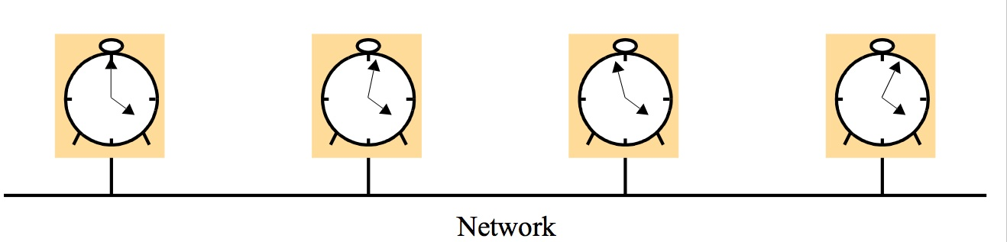
Figure 14.1 Skew between computer clocks in a distributed system
Instructor’s Guide for Coulouris, Dollimore, Kindberg and Blair, Distributed Systems: Concepts and Design Edn. 5 © Pearson Education 2012

Slide 3
Figure 14.2 Clock synchronization using a time server
m
r
m
t
p
Time server,S
Instructor’s Guide for Coulouris, Dollimore, Kindberg and Blair, Distributed Systems: Concepts and Design Edn. 5 © Pearson Education 2012

Slide 4
Figure 14.3 An example synchronization subnet in an NTP implementation
1
2
2
3
3
3
Note: Arrows denote synchronization control, numbers denote strata.
Instructor’s Guide for Coulouris, Dollimore, Kindberg and Blair, Distributed Systems: Concepts and Design Edn. 5 © Pearson Education 2012

Slide 5
Figure 14.4 Messages exchanged between a pair of NTP peers
Server B
T
i
-2
T
i-1
Time
m
m'
Time
Server A
T
i
-
3
T
i
Instructor’s Guide for Coulouris, Dollimore, Kindberg and Blair, Distributed Systems: Concepts and Design Edn. 5 © Pearson Education 2012

Slide 6
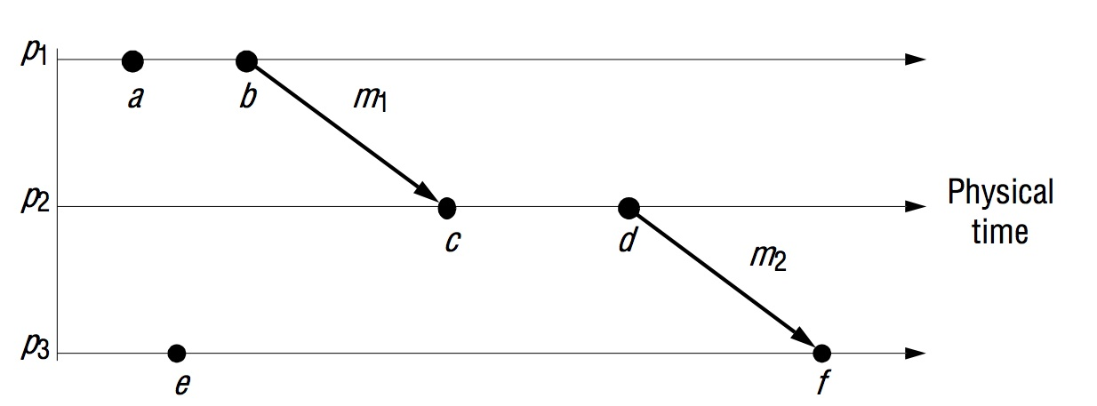
Figure 14.5 Events occurring at three processes
Instructor’s Guide for Coulouris, Dollimore, Kindberg and Blair, Distributed Systems: Concepts and Design Edn. 5 © Pearson Education 2012

Slide 7
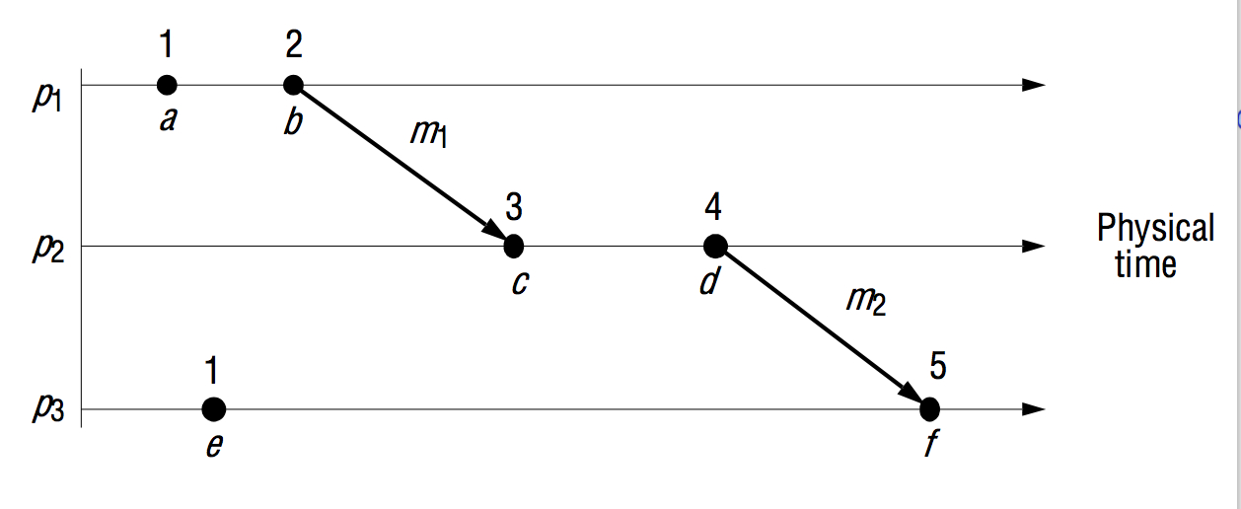
Figure 14.6 Lamport timestamps for the events shown in Figure 14.5
Instructor’s Guide for Coulouris, Dollimore, Kindberg and Blair, Distributed Systems: Concepts and Design Edn. 5 © Pearson Education 2012

Slide 8
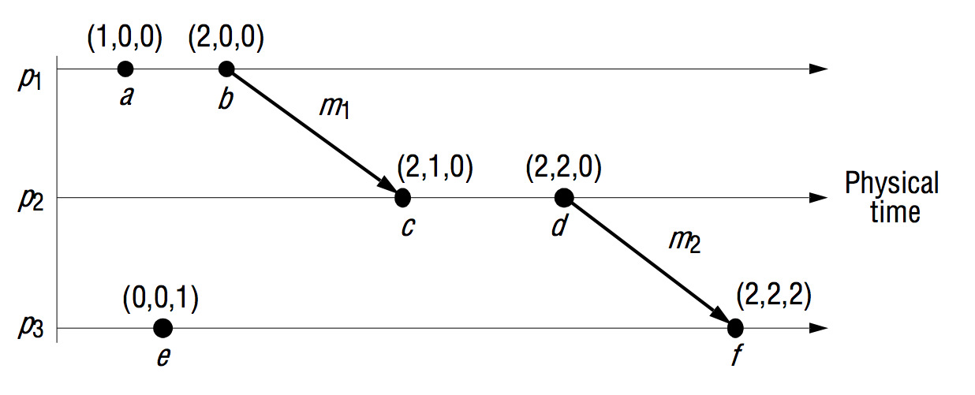
Figure 14.7 Vector timestamps for the events shown in Figure 14.5
Instructor’s Guide for Coulouris, Dollimore, Kindberg and Blair, Distributed Systems: Concepts and Design Edn. 5 © Pearson Education 2012

Slide 9
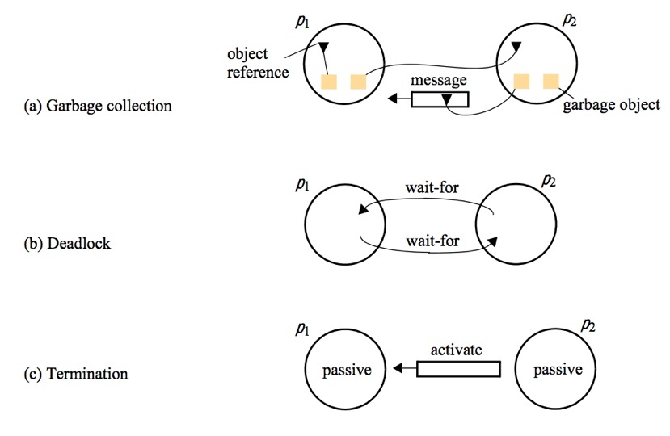
Figure 14.8 Detecting global properties
Instructor’s Guide for Coulouris, Dollimore, Kindberg and Blair, Distributed Systems: Concepts and Design Edn. 5 © Pearson Education 2012

Slide 10
Figure 14.9 Cuts
e
0
e
1
e
2
e
3
1
1
1
1
p
1
m
1
m
2
p
Physical
2
time
e
0
e
1
e
2
2
2
2
Inconsistent cut
Consistent cut
Instructor’s Guide for Coulouris, Dollimore, Kindberg and Blair, Distributed Systems: Concepts and Design Edn. 5 © Pearson Education 2012

Slide 11
Figure 14.10 Chandy and Lamport’s ‘snapshot’ algorithm
Marker receiving rule for process p_{i}
On p_{i}’s receipt of a marker message over channel c:
if (p_{i} has not yet recorded its state) it
records its process state now;
records the state of c as the empty set;
turns on recording of messages arriving over other incoming channels;
else
p_{i} records the state of c as the set of messages it has received over c
since it saved its state.
end if
Marker sending rule for process p_{i}
After p_{i} has recorded its state, for each outgoing channel c:
p_{i} sends one marker message over c
(before it sends any other message over c).
Instructor’s Guide for Coulouris, Dollimore, Kindberg and Blair, Distributed Systems: Concepts and Design Edn. 5 © Pearson Education 2012

Slide 12
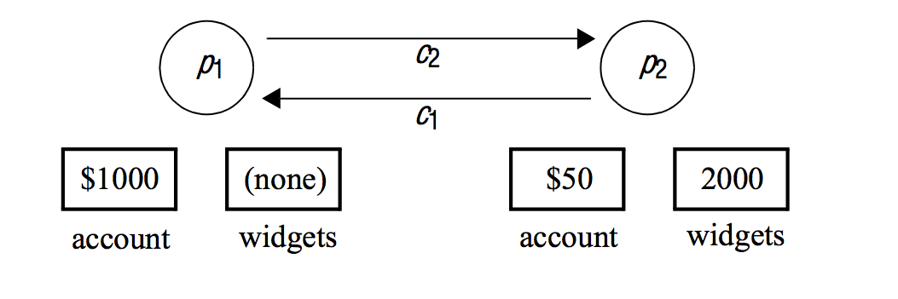
Figure 14.11 Two processes and their initial states
Instructor’s Guide for Coulouris, Dollimore, Kindberg and Blair, Distributed Systems: Concepts and Design Edn. 5 © Pearson Education 2012

Slide 13
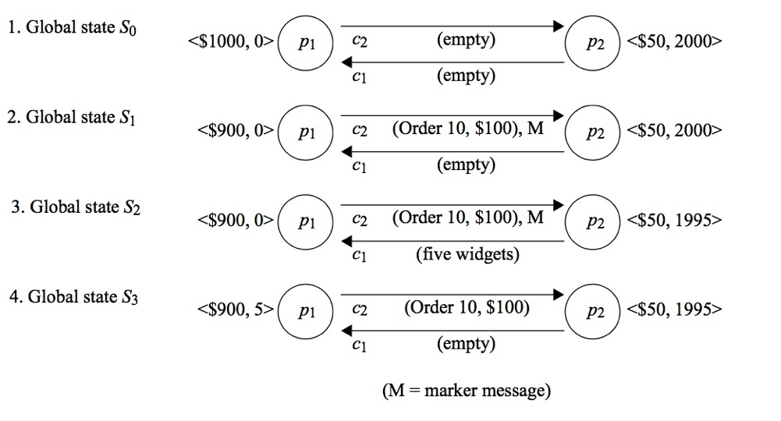
Figure 14.12 The execution of the processes in Figure 14.11
Instructor’s Guide for Coulouris, Dollimore, Kindberg and Blair, Distributed Systems: Concepts and Design Edn. 5 © Pearson Education 2012

Slide 14
Figure 14.13 Reachability between states in the snapshot algorithm
actual execution e
0
,e
1
,...
S
recording
recording
S
init
begins
'
final
ends
S
snap
pre-snap: e'
,e '
,...e
'
post-snap: e '
,e '
,...
0
1
R-1
R
R+1
Instructor’s Guide for Coulouris, Dollimore, Kindberg and Blair, Distributed Systems: Concepts and Design Edn. 5 © Pearson Education 2012

Slide 15
Figure 14.14 Vector timestamps and variable values for the execution of Figure 14.9
(1,0)
(2,0)
(3,0)
(4,3)
x
1
= 1
x
1
= 100
x
1
= 105
x
1
= 90
p
1
m
1
m
2
p
Physical
2
time
x
2
= 100
x
2
= 95
x
2
= 90
(2,1)
(2,2)
(2,3)
Cut C
2
Cut C
1
Instructor’s Guide for Coulouris, Dollimore, Kindberg and Blair, Distributed Systems: Concepts and Design Edn. 5 © Pearson Education 2012

Slide 16
Figure 14.15 The lattice of global states for the execution of Figure 14.14
Level 0
S
00
1
S
10
2
S
20
Sij = global state after i events at process 1
and j events at process 2
3
S
30
S
21
4
S
31
S
22
5
S
32
S
23
6
S
33
7
S
43
Instructor’s Guide for Coulouris, Dollimore, Kindberg and Blair, Distributed Systems: Concepts and Design Edn. 5 © Pearson Education 2012

Slide 17
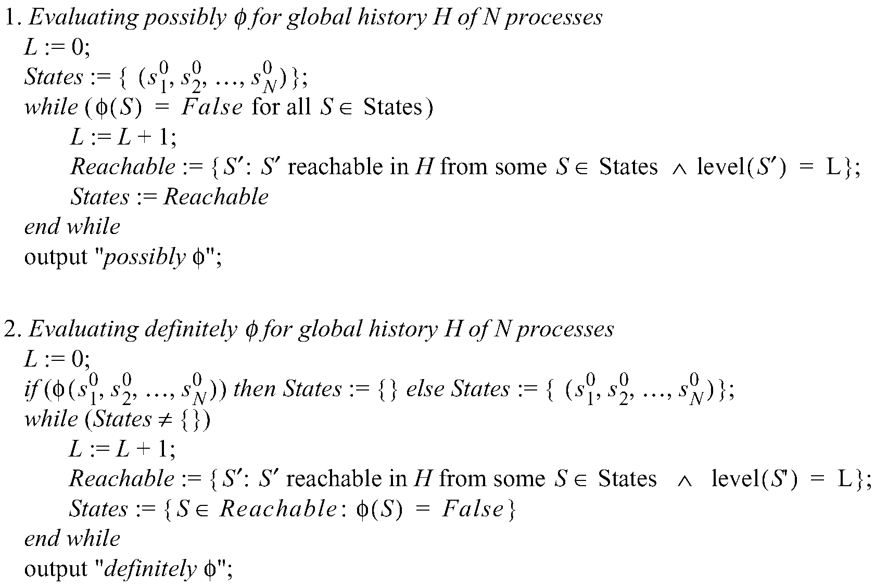
Figure 14.16 Algorithms to evaluate possibly φ and definitely φ
Instructor’s Guide for Coulouris, Dollimore, Kindberg and Blair, Distributed Systems: Concepts and Design Edn. 5 © Pearson Education 2012

Slide 18
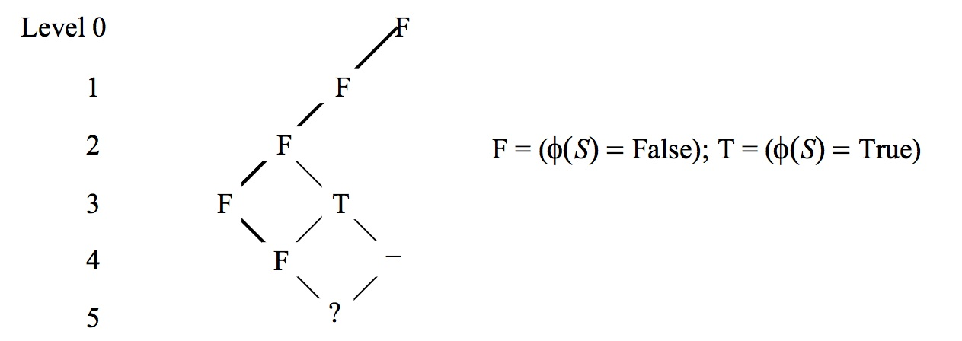
Figure 14.17 Evaluating definitely φ
Instructor’s Guide for Coulouris, Dollimore, Kindberg and Blair, Distributed Systems: Concepts and Design Edn. 5 © Pearson Education 2012

